Slide 1
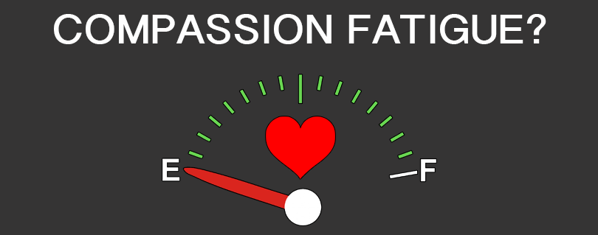
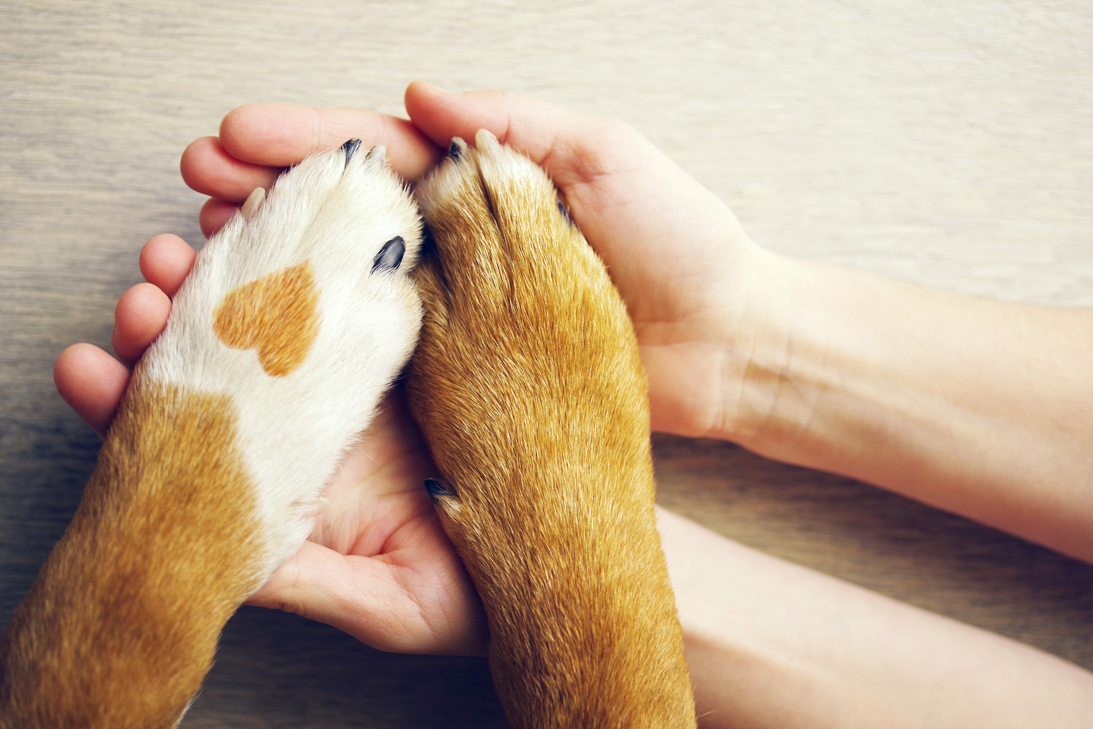
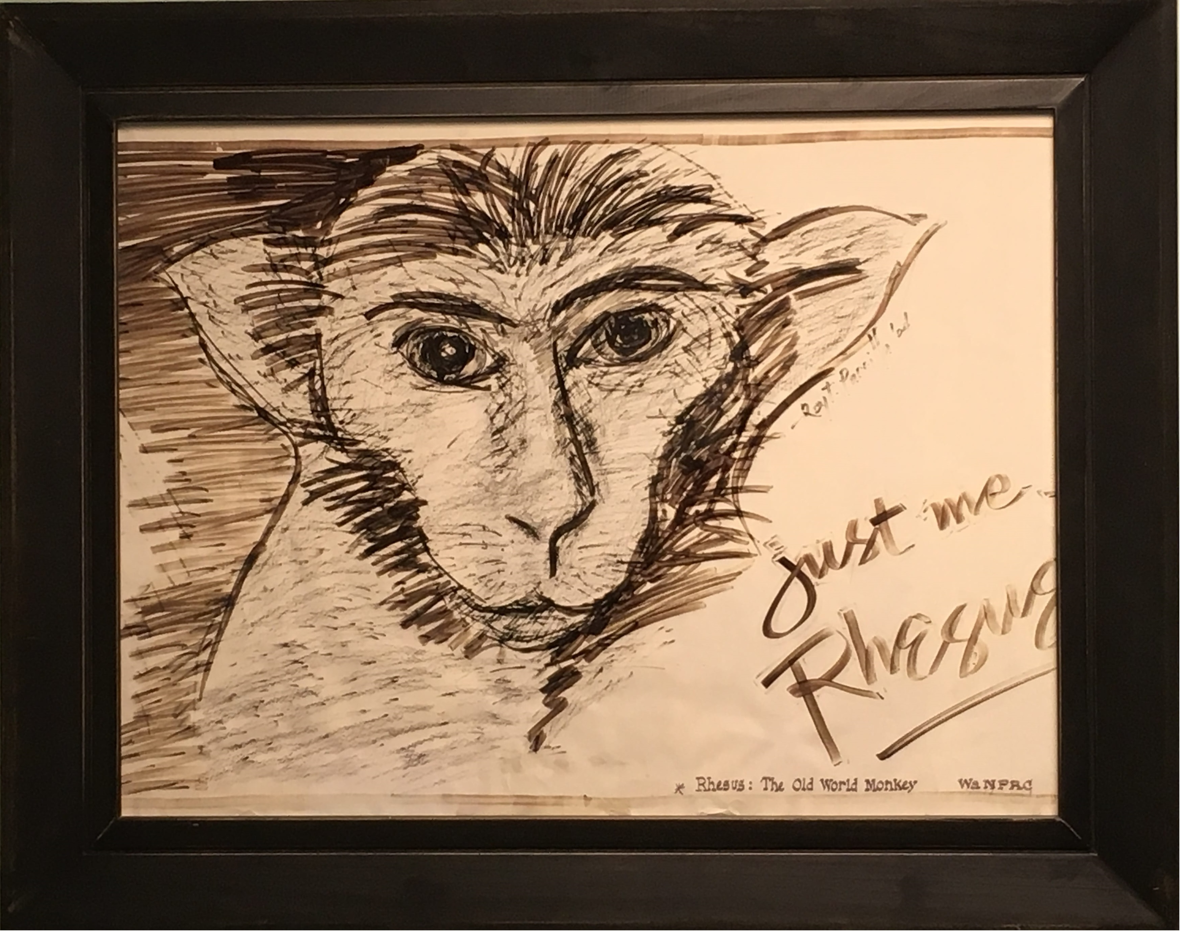
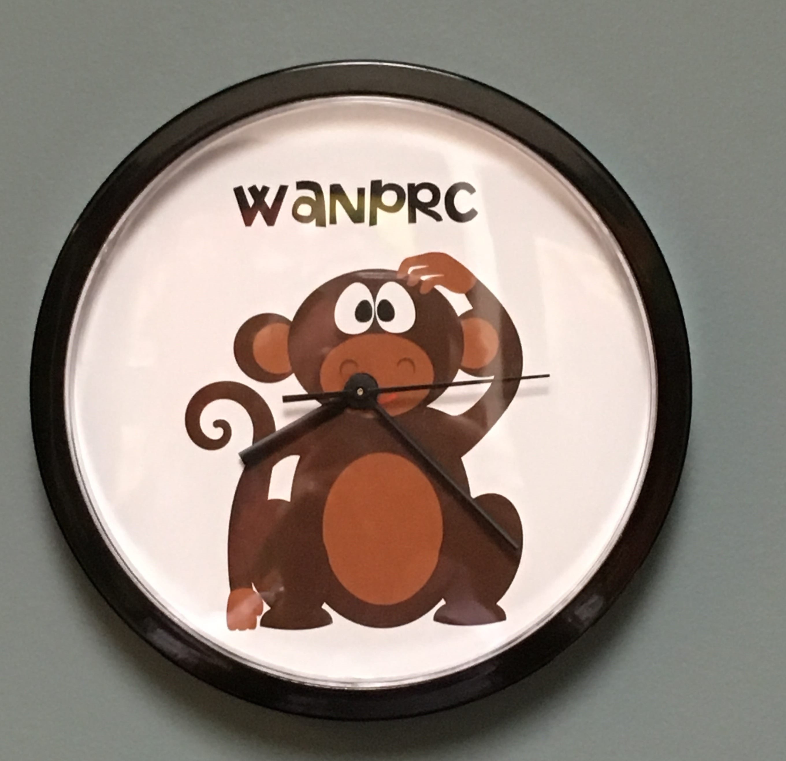
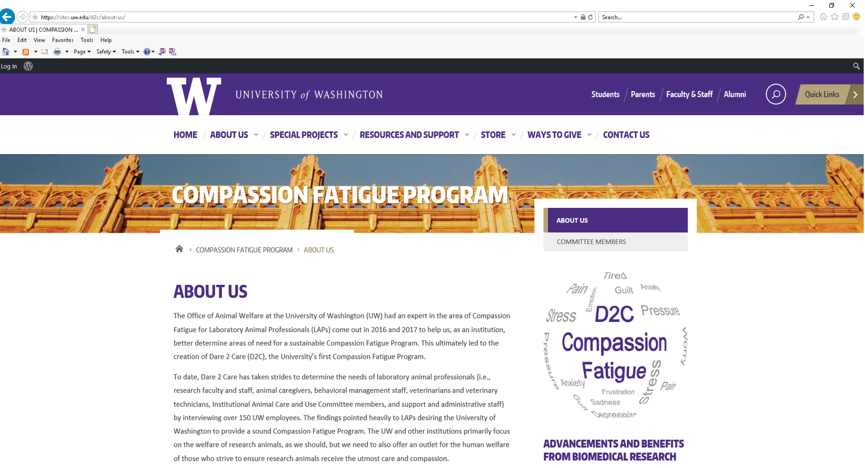
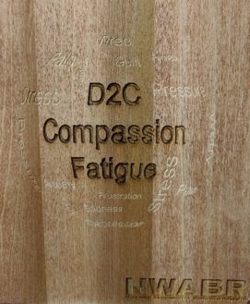
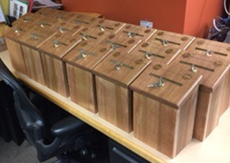
Dare 2 Care:
Developing a Program to Manage Compassion Fatigue
Amongst Animal Caregivers Across Industries
Rita Bellanca**, J. Preston Van Hooser*, Kelly Heffernan*, Anthony Gray**, Sally Thompson-Iritani**
University of Washington, Office of Animal Welfare* and Washington National Primate Research Center**
ABSTRACT: Careers involving animals are an intriguing combination of rewards and challenges, and people are drawn to these careers because they care about animals. In most circumstances, the benefits far outweigh the costs. However, when the work is strained by limited resources, conflicting priorities and the stress of making end of life decisions, it may result in exhaustion and emotional conflict- otherwise known as Compassion Fatigue (CF). Compassion Fatigue is a combination of physical, emotional and psychological depletion associated with caring for animals and their well-being in a captive environment. Previously, the term was used exclusively in conjunction with human-to-human caregiving but with surprisingly high rates of depression and suicide documented in veterinarians, and stress disorders evident, but likely under-reported, in other animal caregivers, it has become clear that they experience CF as well. At the University of Washington (UW), we have developed the Dare 2 Care (D2C) Compassion Fatigue Program for our Laboratory Animal Professionals. This program seeks to acknowledge and normalize the fact that caring and emotional investment are essential to caregiving, something that is often ignored or downplayed. D2C goals include promoting self-care, increasing communication, improving human workplace environments, and implementing community events that emphasize the positive aspects of our work. We will describe how this program was created, what we’ve learned during its implementation, and most importantly, how to identify CF and what types of tools and strategies may be implemented to address it.
What is Compassion Fatigue?
In an animal care setting, Compassion Fatigue is a combination of physical, emotional and psychological depletion associated with working and caring for animals and their well-being in a captive environment.
This may include laboratory settings, zoo environments, or rescue organizations.
The strain of limited resources, conflicting priorities, lack of appropriate self-care and work-life balance, work-related trauma or conflicts, and the stress of making end-of-life decisions are contributing factors.
It is the negative aspect of our work.
Signs and Symptoms – Individual
Support for Staff
When individuals experience grief, anxiety, bereavement or any other form of Compassion Fatigue, it is important that we acknowledge that these feelings exist without shame, guilt or embarrassment.
Addressing this in a safe and supportive environment allows individuals to:
Feel validated
Strengthen their coping mechanisms
Reinforce their ability to sustain or form new bonds
Someone to talk to: One of the most consistently requested mechanisms of support mentioned during our Needs Assessment was simply having someone to talk to - preferably a colleague who understands both the work environment and the emotional commitment.
How do we provide this support?
We educate staff about our D2C Program
D2C volunteers reach out to staff in times of need
We have a dedicated D2C phone line that people can call if they want to talk to someone
We are soliciting a partnership with Occupational Health to include CF in their annual health reviews
We inform staff of other support options, including UW Carelink (employee assistance) and UW SafeCampus
Time and Place for Reflection
We hold quarterly Reflections to provide an opportunity for individuals to come together in one place to pay tribute to our animals and each other, We invite guest speakers to share their research and to acknowledge the contributions provided by all animal care staff. These reflections foster comradery and feelings of pride in the job we are doing.
Depression
Hopelessness
Anxiety
Physical/ emotional exhaustion
Apathy
Bottled-up emotions
Irritability
Feeling overwhelmed
Emotional rollercoaster
Isolation
Forgetfulness
Inability to concentrate
Anger
Self-doubt
Sleep disturbance
Poor self-care
Loss of appetite
An increase in mistakes
Diminished career enjoyment
Substance abuse
Problems in relationships
Friends/Family
Co-Workers
Signs and Symptoms – Organization
Substandard level of care
Absenteeism
High turnover
Lack of teamwork
Team conflict
Low morale
Blaming and complaining
Increased cynicism
Poor quality control
An increase in mistakes
Company reputation may suffer
Deterioration of the organization’s mission
Dedication Area (In Progress)
The Dedication Area will be a physical tribute to all research animals whose lives have been dedicated to the advancement of biomedical research at the UW. Their contributions have not only reduced suffering, but have also saved lives, both of humans and other animals. We envision this space as a peaceful and respectful retreat where staff can go to reflect.
Annual Commemoration (In Progress)
The Dare 2 Care Annual Commemoration will be an opportunity for staff from the entire UW community to gather together to acknowledge our mutual contributions to both biomedical research and animal welfare, and to commemorate the animals in our care. It will be an expanded version of our quarterly Reflections.
Dare to Care (D2C):
How did we get here?
We recognized that the University of Washington (UW) offers training and resources for:
Workplace injuries
Ergonomics
Infectious diseases
Harassment
Disaster planning
Safety
Security
Etc.
But not for the hazards of emotional involvement and Compassion Fatigue.
So we contacted consultant Anneke Keizer
Founder of COPE+; a small company specializing in counseling services for people working with laboratory animals
Anneke helped us conduct a Needs Assessment (Jul 2016 & Jun 2017)
Over 150 staff members were interviewed
Key Concerns / Needs were Identified
The D2C Committee Formed Oct 2016
The volunteer members include veterinary, husbandry, and behavioral staff, research faculty and staff, Office of Animal Welfare and Institutional Animal Care and Use Committee (IACUC) members, and administrative staff. Departments across the University and associated hospitals are represented.
Non-negotiables of self-care
Self-care is vital to preventing (or treating) CF.
We recommend the following essentials:
Eat well
Exercise
Get plenty of rest
Connect with nature
Connect with others
Lessons Learned
Identify possible funding sources early on for:
Additional training / courses
Conference / workshop attendance
Website / curriculum development
Personnel time / investment
Materials / repair costs
Set clear expectations for committee membership:
How are new members added?
What level of participation is required?
Subcommittees may be necessary - make sure goals are aligned and consistent with the full committee
Plan to provide continued education:
Educate all levels of staff about CF, both new and seasoned personnel
Recognize that not everyone will feel, or admit to feeling, CF - and that’s OK
Remain independent:
To avoid conflicts of interest
Set guidelines for how volunteers reach out to staff in need:
Know when to refer someone to a professional counselor
Be aware of your own self-care needs when providing a sympathetic ear to coworkers
Do not get embroiled in HR-related disagreements - refer to appropriate staff
The Human-Animal Bond
The human–animal bond exists in many forms and it can improve both human and animal welfare. Close contact with animals can create feelings of satisfaction and affection.
However, it can also lead to grief, anxiety and bereavement upon the loss of an animal.
Work Environment / Break Areas
Improving break rooms was frequently requested during our Needs Assessments. Staff wanted a safe environment in which to de-stress. Repairs and a change in décor can work wonders!
The Cost of Caring
It’s unrealistic to think people can do what we do and not be impacted. We cannot expect high levels of animal CARE without employees then CARING about the animals.
We don’t get CF because we are weak, can’t handle the work, aren’t “cut out” for it, etc. We get CF because we care deeply. And we ignore our own needs.
UW D2C Program Mission Statement
Assist all members of the research team to recognize Compassion Fatigue and raise awareness, provide tools, strategies and resources for managing human emotions in working with and caring for laboratory animals.
The Box Project
An innovative way to encourage staff to express themselves via art, poetry or simply writing a note of remembrance.
The Boxes were handmade and donated!
Allows staff to express themselves anonymously
Not a complaint box!
Resources
UW’s D2C: https://sites.uw.edu/d2c
COPE+: http://copeplus.com
http://www.figleyinstitute.com
http://www.compassionfatigue.org
Initial D2C Program Objectives
Support for Staff
Self-Care Strategies
Work Environment Improvements
The “Box” Project
Endpoint Notification
Time for Reflection
Dedication Area
Annual Commemoration
Acknowledgments
Anneke Keizer for all of her efforts in assessing our needs and encouraging the formation of our committee.
Ken Gordon, Executive Director of Northwest Association for Biomedical Research (NWABR) for creating all of the boxes for the Box Project.
Grace Lee for her keen editing eye.
Holly Nguyen for co-creating our wonderful D2C website.
All of our UW D2C committee members who volunteer their time, energy, ideas, enthusiasm, and sympathetic ears.
ALL animal caregivers, across industries, for all that you do to promote animal health and welfare, animal conservation, animal rescue, and humane research that benefits both humans and animals.
Endpoint Notification
Provide Endpoint notification to all animal care staff in a timely manner
Acknowledge high levels of humane care
Acknowledge the greater purpose the animal served

