Slide 1
The why and how of data security
Your Role in Data Stewardship
Department of Medicine IT Services

Slide 2
What is data stewardship?
Minimizing risk that private information falls into public hands
Confidential – Protection of data required by law
Patient information (PHI) - Protected by HIPAA
Student information (FERPA) - Individual Student Records
Individual Financial Information - (e.g., credit card, bank) and Personal Information (e.g., social security #, driver’s license #) – Protected by Washington state’s Personal Information law
Personal information (Gotcha!) - (e.g., home address, personal contact information, performance reviews) – Protected by Washington state’s public records law
Proprietary/research information - Intellectual property or trade secrets – Protected by Washington state’s public records law
Restricted - Data that is not regulated, but for business purposes, is considered protected either by contract or best practice.

Slide 3
Why worry about it?
Personal consequences
Professional obligations
HIPAA reporting cascade
All breaches must be reported to feds OCR (Office for Civil Rights investigation)
All individuals affected must be notified; if more than 10 lack addresses, public notice on web
If more than 500 affected, media must be informed

Slide 4
What is a Breach?
Unauthorized acquisition, access, use, or disclosure of sensitive information that compromises the security or privacy of the information.
The US Department of Health and Human Services (DHHS) identifies two methods of securing PHI:
Destruction
Encryption
No breach occurs if a compromised device is encrypted and password protected.
If a device is compromised and is not encrypted and password protected, the burden of proof is on you to show there was no confidential data stored on it.

Slide 5
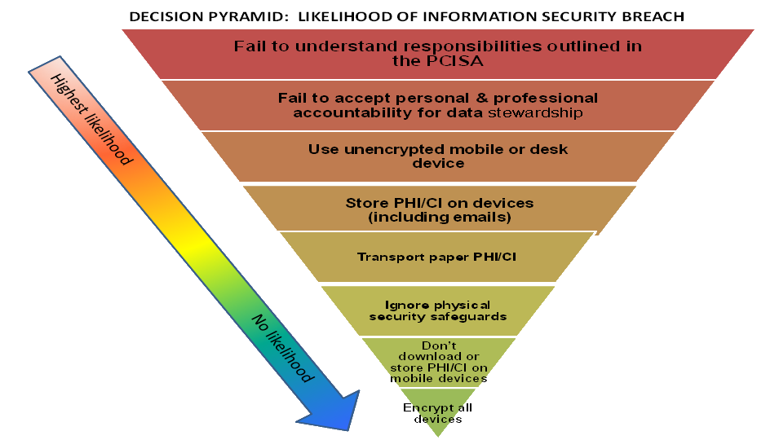
Decision Pyramid: Likelihood of Information Security Breach

Slide 6
Responsibilities
Everyone who is using or viewing confidential or patient information must be personally and professionally accountable for safeguarding that information.
Users (YOU) are responsible for the safekeeping of data under your care.
Minimize your responsibility by limiting the data under your care.

Slide 7
Who to Contact if a Breach Occurs?
Contact Jennifer Dickey and Walt Morrison if a breach occurs.
Jennifer Dickey: jennd@medicine.washington.edu; 221-5947
Walt Morrison: wmorrison@medicine.washington.edu; 616-4726
Notes:
Personal Consequences
Loss of patient and public trust
Your name is reported to
Your program director, department chair, executive director and/or unit head
CEO, UW Medicine and Dean of the School of Medicine, University of Washington
UW Medicine Chief Health System Officer
UW Health Sciences Risk Management
UW Chief Information Security Officer
Federal and State regulatory agencies
The time you will spend cooperating with investigations, being retrained, and other remedial activities
Imposition of sanctions, disciplinary actions, and potential civil/criminal penalties
Your personal and professional reputation
Institutional Consequences
Potential loss of public trust in UW Medicine
Significant time and resources to investigate, conduct forensics, analyze findings and determine appropriate course of action
Involvement of legal counsel, risk management, executive directors, unit heads
Federal law requirements regarding notification
Call center for each case requiring patient notification
Office of Civil Rights Investigation
Possible imposition of civil/criminal penalties, fines and sanction

Slide 8
Principle: Data thrift
Don’t be responsible for data you don’t need
Only store sensitive material on mobile devices if it is absolutely necessary.
Compute in place:
Use internal systems (e.g. ORCA/Epic patient lists) to track information
Use institutionally owned servers to store data
Utilize the Department of Medicine’s NetExtender SSL VPN or AMC’s Juniper SSL VPN service for remotely accessing UW resources.
Use a terminal server or remote desktop access to your workstation
Avoid using computers you are not personally responsible for to access UW resources.
Can you do it with de-identified information?

Slide 9
Principle: Physical security
Keep paper and physical documents in a safe place
Keep computers behind locked doors
Keep mobile devices close at hand
Lock computers while unattended.
CTRL + ALT + DEL → Enter
Windows Key + L

Slide 10
Principle: Encrypted storage
Encryption: scrambling data so it’s practically irretrievable without the key (passphrase)
All desktop and most mobile operating systems support encryption; many flash drives also include encryption software
Encryption is only as strong as its passphrase
“Cloud” storage is generally unsafe and not approved for use unless specifically approved by UW

Slide 11
Principle: Encrypted transport
A minimally skilled hacker (or moderately skilled lawyer) can read the email you send outside of UW
“From” addresses can easily be faked
Secure web connection prevents “listening in”, helps verify authenticity of both parties
VPN, Citrix both good options for enterprise use

Slide 12
Principle: Strong Passwords
Use the full keyboard.
Variety in character types and length makes passwords exponentially stronger.
Don’t use single words or names.
String multiple random words together to form a long password.
Random sentences are a good example.
A strong password (required by policy) must:
Be at least 8 characters long.
Mix upper and lower case letters.
Include numbers and symbols.

Slide 13
Smartphone/Tablet Security
Use a strong password to lock the device.
Enable encryption.
Set an automatic lockout timer on the device.
No greater than 15 minutes.
Don’t use cloud backup services.
iOS devices – Use iTunes encrypted backups (http://support.apple.com/kb/HT4946)
Android devices – Helium (available in the Play Store)
Initiate a device wipe after 10 failed password attempts.
If the device supports this
Don’t store data on the SIM card (contacts, SMS, etc).
Notes:
Lockout information for various devices:
iPhone: 1-5 bad attempts = no lockout delay, 6th = 1 min, 7th = 5 min, 8th = 15 min, 9th = 60min.
Android 4+: Varies on model and carrier since many do not run the stock Google version of Android. Many have a 30 second lockout on every 5th bad attempt.
Windows 8 Mobile: 5th = 1 min, 6th = 2 min, 7th = 4 min, 8th = 8 min, 9th = 16 min.
Blackberry 10: On by default, cannot be turned off. Lockout timer between failed attempts is currently unknown.

Slide 14
Email Security
All email containing Restricted or Confidential data must be secured in transport.
Encrypted connections must be used between email servers.
Messages between University email systems (Outpost, UW Exchange, and UW Deskmail) and some recipients are automatically encrypted.
This encryption only applies to message data while it moves between servers. It likely will not be encrypted once it reaches its destination mail server.
Restricted or Confidential information sent over email must be delivered to a secure system.
UW Medicine maintains a list of pre-approved email systems on their site: https://security.uwmedicine.org/guidance/technical/email/approved_list.asp.
Email in Outlook (and other email clients) is cached on the local machine, as are any attachments you open from email messages.
This information can be retrieved offline if the local storage of the device is not encrypted.

Slide 15
Key points
Delete anything sensitive; better yet don’t copy it in the first place
Keep everything you can in a safe place
Encrypt anything that moves
Use multiple, secure passwords
Be suspicious; trust no email
Spread the word!

Slide 16
Informational Resources
Discussion Tool / Checklist for Employees https://depts.washington.edu/domweb/forms/IT_PCISADiscussionTool.pdf
Privacy, Confidentiality and Information Security Agreement for all Employees (part of onboarding process/DoM IT inventory of current users)
https://depts.washington.edu/domweb/forms/IT_PCISA.pdf
UW Medicine Security: https://security.uwmedicine.org/
The Office of the Chief Information Security Officer for the UW provides resources on their site regarding safe computing - https://ciso.washington.edu/
Risk Advisories and Best Practices - https://ciso.washington.edu/resources/risk-advisories/
Online Training - https://ciso.washington.edu/resources/online-training/
A copy of this presentation, as well as technical documentation for securing computers and mobile devices, will be emailed to you.

Slide 17
Where to Get Help
Department of Medicine IT Services
206.616.8805
ishelp@medicine.washington.edu

Slide 18
End of Presentation

